Slide 1
Sir Clive Sinclair
Sir Clive Marles Sinclair (born 30 July 1940) is an English entrepreneur and inventor, most commonly known for his work in consumer electronics in the late 1970s and early 1980s.

Slide 2
Osnovni podaci
Born | Clive Marles Sinclair 30 July 1940 (age 80) near Richmond, Surrey, England
Occupation | Inventor, entrepreneur
Employer | Sinclair Research
Spouse(s) | Ann Trevor-Briscoe (1962–1985) Angie Bowness (2010–2017)
Children | Belinda, Crispin, Bartholomew
Parent(s) | George William Carter Sinclair Thora Edith Ella Marles

Slide 3
ZX81

Slide 4
ZX Spectrum

Slide 5
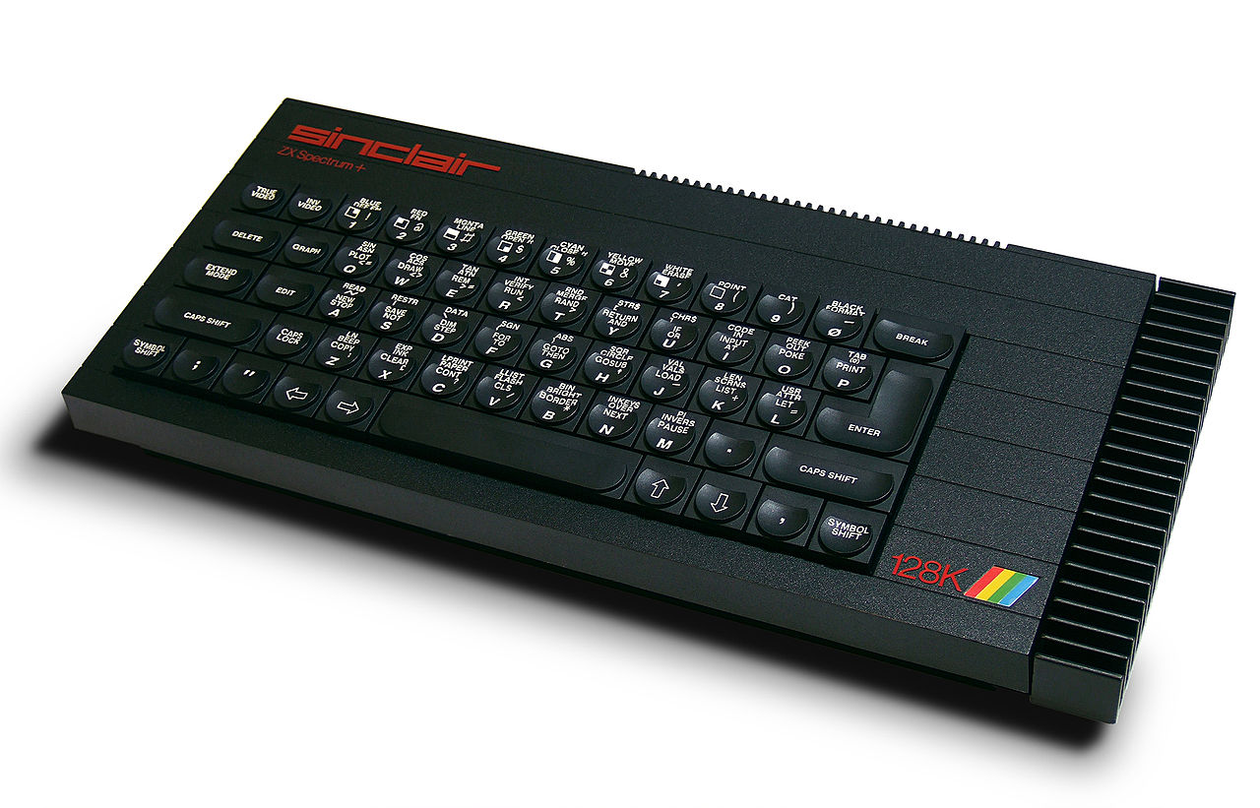
ZX Spectrum 128K

Slide 6
Personal life
Sinclair is a poker player and appeared in the first three series of the Late Night Poker on Channel 4. He won the first series final of the Celebrity Poker Club spin-off. On his religious views, Sinclair calls himself an atheist.^{[16]} He is a member of British Mensa and was chairman for 17 years from 1980 to 1997.^{[12]} Sinclair was awarded the Honorary Degree of Doctor of Science by the University of Bath in 1983.^{[17]} He was knighted in the Queen's 1983 Birthday Honours List.
Despite his involvement in computing, Sinclair does not use the Internet, stating that he does not like to have "technical or mechanical things around me" as it distracts from the process of invention.^{[18][19]} In 2010 he stated that he does not use computers himself, and prefers using the telephone rather than email.^{[20]}

